Slide 1
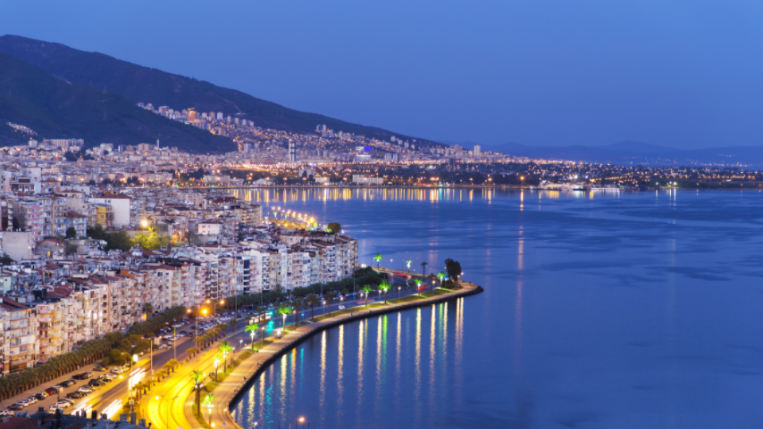
Finding suitable restaurants for tourists for their tastes,
which neighborhoods of İzmir have vegetarian friendly restaurants
The beautiful İzmir

Slide 2
Introduction/Business Problem
İzmir is a city on Turkey’s Aegean coast.
It is the third most populous city in Turkey, a tourist attraction place of interest
For tourists, who prefer vegetarian food, finding a right place to eat can be a daunting challenge, especially in a country like Turkey, where meat heavy dishes like Kebab, Doner are the most popular ones.
Turkey is famous for its meat culture and is not quite vegetarian friendly.
Discovery of Izmir by studying districts and neighbors applying machine learning tools and try to find best fits for their needs.

Slide 3
Description of the problem
The aim of this project is to explore, cluster, and segment the neighborhoods in the city of İzmir and give recommendations to tourists, immigrants, friends , who are vegetarian and coming from the world to visit İzmir, based on the common restaurant categories in different neighborhoods.
Where to open restaurants depending on their types in İzmir?’
What are the most frequently occurring venues in İzmir
Which neighborhood has the higher number of of restaurants depending on its type?
Where to find vegetarian-friendly restaurant, sea foods restaurants?

Slide 4
Data
İzmir data, which contains the list of districts, neighborhoods and their latitudes and longitudes.
Captured from 'https://www.atlasbig.com/tr/izmirin-mahalleleri’
There are 29 districts and 178 neighborhoods in İzmir.
The Foursquare location data is used to fetch all the venues in each neighborhood by their coordinates

Slide 5
Methodology
Collecting data
By using beautiful soup, I found the data from data source from https://www.atlasbig.com/tr/izmirin-mahalleleri
Data Preparation and Cleansing
Cleaning and merging your data and put it into dataframes
Getting Coordinates of neigbourhoods from Geopy Client
Using geopy library to get The latitude and longitude values of Izmir
Folium library to visualize geographic details of Izmir and its boroughs
FourSquare to find venues and all restaurants.
Applying Machine Learning Algorithms
One hot encoding to transform data from categorical data into numerical data
K-Means clustering algorithm To cluster the neighbourhoods of Izmir based on the venue categories

Slide 6
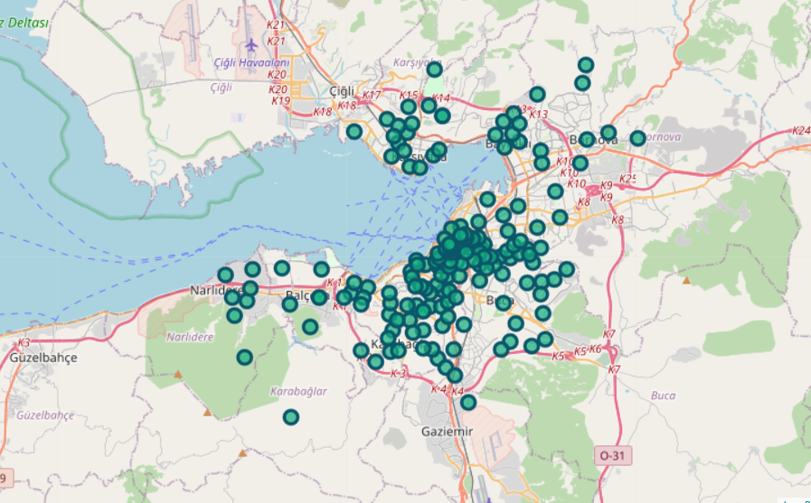
Results and Discussion
Now we can see all the neighbourhoods of Izmir visualized on the map.

Slide 7
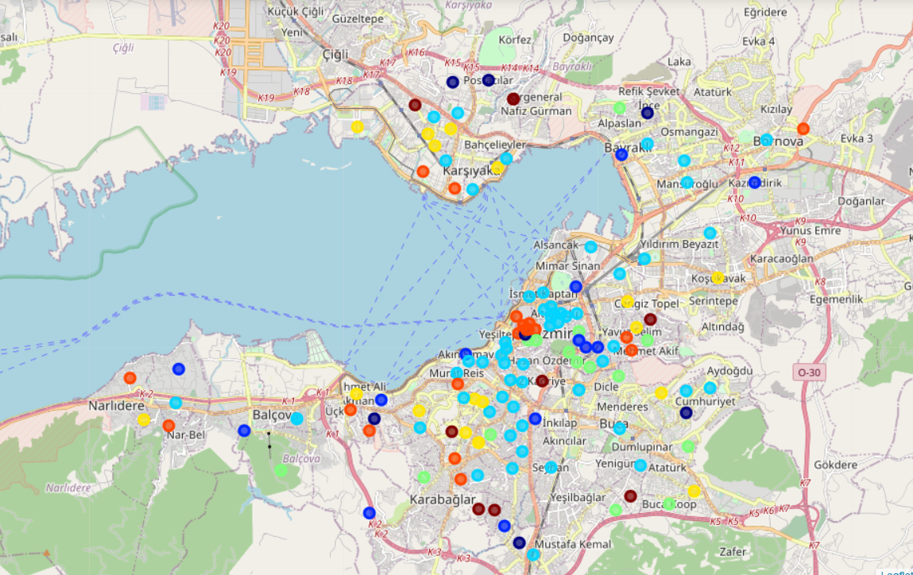
Visulaization of Izmir’s restaurants after applying clustering algorithm

Slide 8
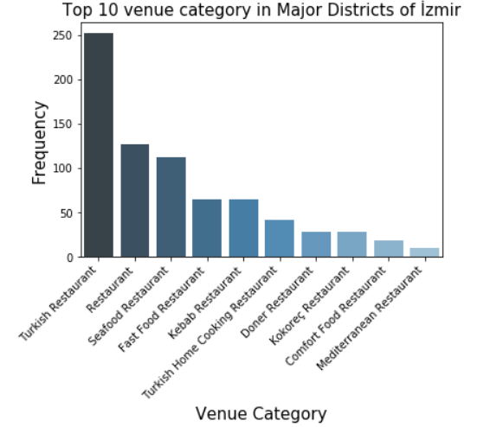
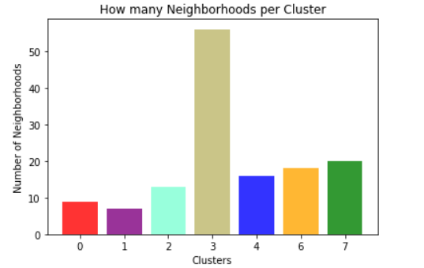
Obiviously, Turkish restaurants are the most popular one alongside with Kebab, Doner, Kokorec. Since Izmir is a coastal Aegean city, Seafood restaurants are popular too. Some of the seafood restaurants might be vegetarian or vegan restaurants.
cluster 3 which is the light blue circle on the map has the most neighborhoods. This is due to fact that this particular area is the most popular place to visit for locals in Izmir

Slide 9
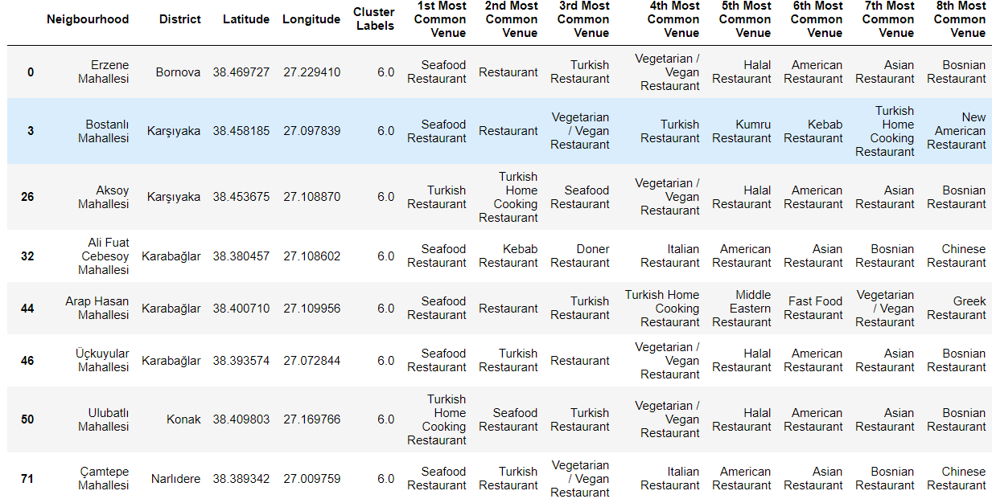
Cluster6 is dominated by Seafood restaurants and Vegetarian / Vegan Restaurants. So if you are a Vegetarian, these are the neighbourhood you want to visit.

Slide 10
Insights
Turkish restaurants top the charts of most common venues all districts following by Seafood restaurants
Konak , Karşıyaka, and Karabağlar have the maximum number of restaurants.
Cluster6 is dominated by Seafood restaurants and Vegetarian / Vegan Restaurants. So if you are a Vegetarian, these are the neighbourhoods that you want to visit. I recommend going somewhere close to the sea side like Bostanlı Karşıyaka 😊

Slide 11
Conclusion
Built a model to explore Izmir’s neighborhoods and its restaurants
Used FourSquare, Folium library, geopy client
Segmented the neighborhoods in the city based on the common restaurant categories in different neighborhoods.
Created 7 clusters by applying ML techniques
Shortlisted the neighborhoods based on the common venues and decided a neighborhood which best suits to our problem.

